Slide 1


ITSM Roadmap:
A Strategic Implementation Plan
Use this customizable framework for planning, executing, and improving your ITSM journey.
www.vivantio.com | info@vivantio.com | +44-1934-424840
Notes:
[Andy]
Welcome and thank you for attending our session on Driving Growth with Customer Service and Support.
I’m Andy Walsh and I’m the Chief Operating Officer at Vivantio, at Vivantio we have been developing Service Management software in the UK since 2003 focusing on Customer Service Management, IT Service Management and service management across the whole enterprise. I’ve been with Vivantio pretty much since the start of the journey for myself and the company over the last 19 years and it has been fascinating to see how customer service both internal and external has evolved over that time and we will be talking about certain aspects of that in this session today.

Slide 2
Roadmap Overview
Define strategic objectives for your ITSM implementation
Visualize phases, timelines, and key owners
Track progress and maturity over time
Adapt roadmap to organizational goals and changes

Slide 3
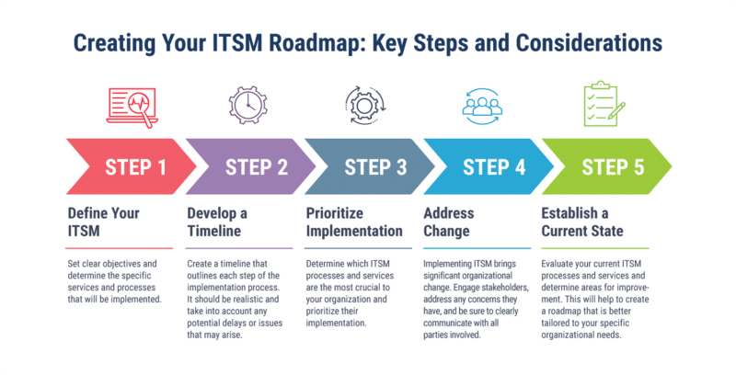

Slide 4
ITSM Implementation Timeline (Gantt View)

Slide 5

Phase Breakdown Template
Phase: [e.g., Define Strategy]
• Milestones:
• Owners:
• Deliverables:
• Risks/Blockers:
• Timeline:

Slide 6

Stakeholder Engagement Plan
List stakeholders and define communication cadence:
• Executive Sponsor: [Name/Title]
• IT Leadership: [Frequency of updates]
• Business Units: [Feedback sessions, training needs]
• Change Agents: [Roles & Influence]

Slide 7

ITSM Maturity & Success Metrics
Define your current state and targets for the following:
• CSAT
• SLA Adherence
• MTTR / FCR
• Maturity Level (1–5)
*Include visual indicators or graphs to represent progress.

Slide 8

Continuous Improvement Plan
Quarterly roadmap review
Feedback loop from service teams
Service catalog evolution
CMDB updates
New initiatives or integrations
* Use this slide to plan iterative improvements.

